Slide 1
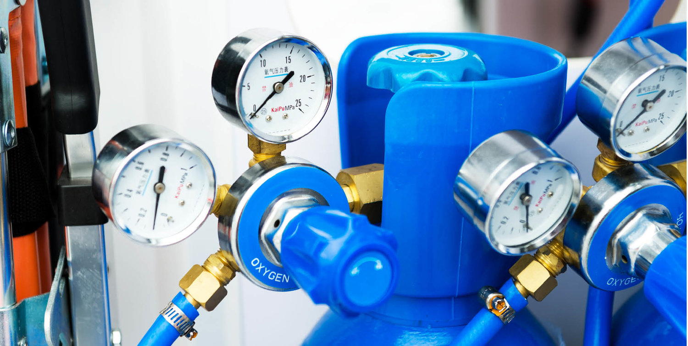


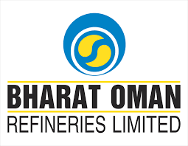
PROPOSAL — MADHYA PRADESH MEDICAL & INDUSTRIAL OXYGEN MARKET
April 15, 2021
Prepared for:
www.chemanalyst.com
MARKET INTELLIGENCE . CONSULTING

Slide 2
Proposal Flow
Contents
Project Outline and Background ………………………….………………………………………………………………………….…......... 3
Scope of Work ……………………………………………………………………………………………………………………………………4
Research Methodology…………………………………………………………………………………………………................................. 8
Project Execution Plan ……………………………………………………………….……..………………………………………………… 13
Project Communications…………………………………………………………………………………………………………………,,,..... 14
Project Organizations………………………………………………………………………………………………………........................... 15
Investment…………………………………………………………………………………………………………………………..…………...16
TechSci Research Team Profile………………………………………………………………………………………………………………17
Representative Case Studies………………………………………………………………………………………………………………….19
Representative List Of Clients…………………………………………………………………………………………………………………21
About TechSci Research……………………………………………………………………………………………………….………..........22
Award & Recognitions ......……………………………………………………………………………………………………….……….......25
TechSci In Media ….......……………………………………………………………………………………………………….………..........26

Slide 3
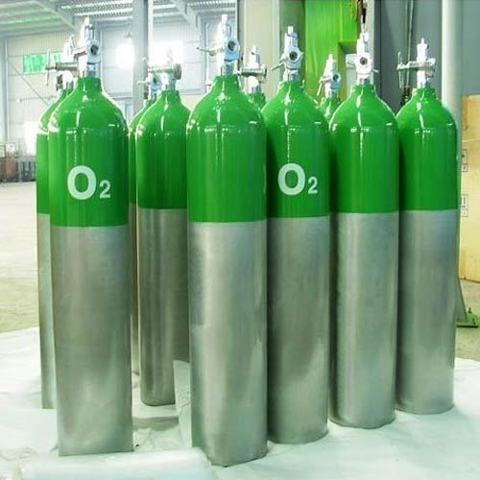
Project Outline and Background
Bharat Oman Refineries Limited was incorporated in 1994 as a Public Limited Company with equal equity participation of Bharat Petroleum Corporation Limited (“BPCL”, a Government of India Undertaking) and OQ (formerly OOC). Presently, BPCL is holding 63.4% and OQ is holding 36.6% equity in the Company. The company has become subsidiary of BPCL effective from 1st April, 2020. The Government of Madhya Pradesh is also stakeholder in the Company. Since commissioning, the Company has achieved significant milestones and has recently implemented the debottlenecking project to enhance capacity from 6.0 to 7.8 MMTPA with capability to produce 100% BS-VI specifications fuel. BORL wants to diversify into specialty chemicals business having lower capex and high margin opportunities.
The client is looking for a customized study to identify possibilities for marketing of medical and industrial oxygen within 200 KM radius of Bina, Madhya Pradesh
ChamAnalyst is submitting this proposal covering scope of work, methodology, timelines and other details

Slide 4


Scope of Work

Slide 5
Product: Oxygen
Oxygen is an odourless gas which is necessary to maintain life. It is widely used in medical sector to:
Provide basis for all modern anesthetic techniques
Improve tissue oxygen tension by enhancing oxygen availability in different circumstances such as
Rib fracture and chest wound
Hyperpyrexia, carbon monoxide poisoning, accident & trauma cases
During cardiac arrest and sudden respiratory disorder
Treat severe headache and during newborn resuscitation
Table 1: General Properties of Medical Oxygen
Table 2: Specification for Compressed Medical Oxygen
Property | Remark
Physical | Odourless & colourless gas
Molecular Weight | 32
Boiling Point | –183°C (at 1 bar)
Density | 1.335 kg/m3 (at 15 °C)
Shelf Life | 36 Months
Parameter | Remark
Grade | Medical grade I.P.
Purity | Certified pure 99-100%
Damage Factor | Should not cause any damage to the materials of cylinders, gas pipeline, Anesthesia machine and ventilators.
Application | Certified safe for human use

Slide 6
Table of Contents
S. No. | Contents
1. | Product Overview
2. | Research Methodology
3. | Executive Summary
Madhya Pradesh Industrial Oxygen Market (Market assessment and forecast, its distribution, related price points and purchase terms)
4. | Madhya Pradesh Industrial Oxygen Market Outlook (2022-2037)
 | 4.1. | List of Major Demand Centers for Industrial Oxygen and No. of industrial units/factories in 200 Km radius along with their oxygen demand (in MT/Day)
 |  | 4.1.1. | Small
 |  | 4.1.2. | Medium
 |  | 4.1.3. | Large
 | 4.2. | Historical Demand of Industrial Oxygen
 |  | 4.2.1. | No of Factories
 |  | 4.2.2. | Approximate Oxygen Demand Per Factory (MT / Day)
Madhya Pradesh Medical Oxygen Market (Market assessment and forecast, its distribution, related price points and purchase terms)
5. | Madhya Pradesh Medical Oxygen Oxygen Market Outlook (2022-2037)
 | 5.1. | List of Major Demand Centers for Medical Oxygen and No. of hospitals in 200 Km radius along with their medical oxygen demand (in MT/Day)
 |  | 5.1.1. | Small
 |  | 5.1.2. | Medium
 |  | 5.1.3. | Large

Slide 7
Table of Contents
S. No. | Contents
 | 5.2. | Historical Demand of Industrial Oxygen
 |  | 5.2.1. | No of Factories
 |  | 5.2.2. | Approximate Oxygen Demand Per Factory (MT / Day)
6. | Madhya Pradesh Cylinder Oxygen Pricing Analysis
 | 6.1. | Historical Prices – Industrial (2019-2021)
 | 6.2. | Historical Prices – Medical (2019-2021)
7. | Practices for procurement of Medical Gases
 | 7.1. | Payment Terms
 | 7.2. | Contract Duration
 | 7.3. | Procurement Process
 | 7.5. | Rental on Cylinder (Monthly / Annual Charges)
8. | Strategic Recommendations
 | 8.1. | Key Industrial Cluster to target
 | 8.2. | Logistics & Supply Chain Strategies
 | 8.3. | Pricing Strategies

Slide 8

Research Methodology

Slide 9
Research Methodology
Market Profiling
Formulating Questionnaire
Developing List of Respondents
Data Collection
Data Validation
Data Analysis
In-depth secondary research will be conducted to determine top players in the India Medical and Industrial Oxygen market, consumption behavior and segmental market share.
In order to conduct industry experts’ interviews, ChemAnalyst will formulate a detailed discussion guide.
List of industry players and industry specialists will be developed.
ChemAnalyst will conduct interviews with industry experts and industry players for data collection and verification.
Data obtained as a result of primary and secondary research will be validated through rigorous triangulation.
The data will be scrutinized using MS-Excel, statistical tools and internal proprietary database to obtain qualitative and quantitative insights.
Primary Research
Desk Research
Company Analysis
Actionable
Insights
Identifying Key Opinion Leaders
Questionnaire Design
In-depth Interviews
Recent Developments
Market Changing Aspects/Dynamics
Government Policies
Conclusion
Market Participants
Key Strengths
Data
Collection
Data Filter
& Analysis
Research &
Intelligence
Business
Solution
Primary Research
Secondary Research
Paid Sources
LinkedIn
ChemAnalyst Internal Database
Company Websites
Company Annual Reports
White Paper Study
Financial Reports
Investor Presentations
Regulatory Body
Associations, etc.
Factiva
Hoovers

Slide 10
Research Methodology
The recommended methodology for this study is primary research followed by exhaustive Secondary Research.
Phase 1: Chemanalyst will design interview questionnaires for manufacturers, suppliers, end-users, government organisations and industry experts. The objective of these questionnaires would be to understand the market dynamics, emerging trends and competitor analysis specialty chemical market
For Example—Contrcat manufcturing providerswill be targeted to know market, market share by types, by sales, by region, market trends, etc.
Post receiving feedback / approval from Client on questionnaires , Chemanalyst will start executing the surveys across said target audience. Chemanalyst will also conduct mock surveys across target respondents to check the feasibility of the questionnaires and to address the challenges faced, if any, while conducting the surveys and in data collection.
Primary research surveys will be conducted with the identified companies, and they will also be asked for their other competitors in the market. By this way if we may have missed any target company due to limitations of secondary research then we will be able to identify that company and then survey them as well.,
Chemanalyst will also identify channel partners such as distributors, traders and agents
Below mentioned is the number of surveys that would be conducted during the study :
Stakeholders | Manufacturers | End-User | Industry Experts | Regulatory Bodies | Total
Specialty Chemicals | 5 | 200 | 10 | 10 | 225
We do multiple interviews in one organisation at different levels (Mid-Senior) and departments (Sales, Marketing, Production, etc)

Slide 11

Research Methodology
Phase 2: ChemAnalyst will execute primary surveys. In addition, exhaustive secondary research will be done using various credible sources such as company annual reports, white papers, investor presentations, financial reports, international trade associations, etc.
Phase 3: Chemanalyst will perform periodical checks on data being collected through surveys with logic checks and analyze survey results in MS Excel/SPSS and data generated through its proprietary database.
Chemanalyst will also use data triangulation technique to fill the gaps and to present the more meaning picture of the market. In order to forecast the Ride-Hailing market, ChemAnalyst will use various forecast techniques such as: Moving Average, Regression analysis, etc.
ChemAnalyst will also use its own forecast tool, which is based on the growth of various allied industries. Chemanalyst will also use impact analysis during short, medium and long term to estimate the demand and to reach to an accurate market numbers
Phase 4: ChemAnalyst will deliver the final comprehensive project report in detailed PowerPoint Presentation format along with the support documents
Investment information will be sourced from published literature and will be adjusted it for the timeline and the location factors. An assessment will be made for the likely import component based on the materials of construction and type of equipment.

Slide 12
Research Methodology
ChemAnalyst will use its own forecast tool, which is based on the growth of various allied industries located in radius of 200 KM from Bina, Madhya Pradesh refinery. ChemAnalyst will also use the impact analysis during short, medium- and long-term period to estimate the demand and to reach accurate market numbers.
Partial List of Companies to be Interviewed | Key Secondary Sources
Linde India Limited Inox Air Products Goyal MG Gases Private Ltd Malwa Oxygen & Industrial Gases Private Limited Steel Authority of India Limited Sarthak Metals Marketing Pvt. Ltd. Air Liquide S.A. Bharat Heavy Electricals Limited Jindal Steel & Power Limited Chambal Fertilizers & Chemicals Limited AIIMS, Bhopal Bhopal Heart & General Hospital Ltd Ellenbarrie Industrial Gases Limited Bhuruka Gases Limited Uttam Air Products Private Limited Techno Udyog | World Bank ChemAnalyst Research Proprietary Database & Knowledge Repository Company Annual Reports Industry Magazines Industry Reports News Dailies Credible Paid Databases BP Statistics OPEC Bulletin OECD WHO Ministry of Health and Family Welfare, Government of India Un Comtrade Director General of Foreign Trade

Slide 13
Data Representation
Demand Data:
Company to please share List of Major Demand Centers for Industrial Oxygen and No. of industrial units/factories in 200 Km radius along with their oxygen demand (in MT/Day)
S. No | Size | No of Factories | Projected Oxygen demand (in MT/day*) for FY Ending 31st March
 |  |  | 2022 | 2025 | 2030 | 2035 | 2036 | 2037
1 | Small
2 | Medium
3 | Large
Total
Kindly share following data for Demand assessment within 200 Km radius for Industrial Purpose :
Last 3 years oxygen requirement for industrial units in 200 Km radius (in MT/day), as follows:
S. No | FY Ending | No. of Factories | Approx. Oxygen demand per Factory (in MT/Day)
1 | Mar-19
2 | Mar-20
3 | Mar-21

Slide 14


About Parent Organization
ABOUT PARENT ORGANIZATION
TechSci Research
Founded in 2008, we are an independent Global Market Research and India Entry Management Consulting company that helps global companies to Enter, Expand and Succeed in India. With the help of our strategic solutions and business implementation assistance, we have led many brands to enter and establish in India.
Our robust knowledge of India and its policies & regulations, advantages and challenges allows our clients to make choices that ensure long term profitability and growth. We not only help in structuring strategies for clients but also implement what we recommend.
ChemAnalyst Research is driven by a group of encouraged and young individuals who believe in delivering the Best to their clients. Our team includes of specialists from various industries and functions with strong business intelligence and problem solving skills to provide actionable solutions to our clients

Slide 15


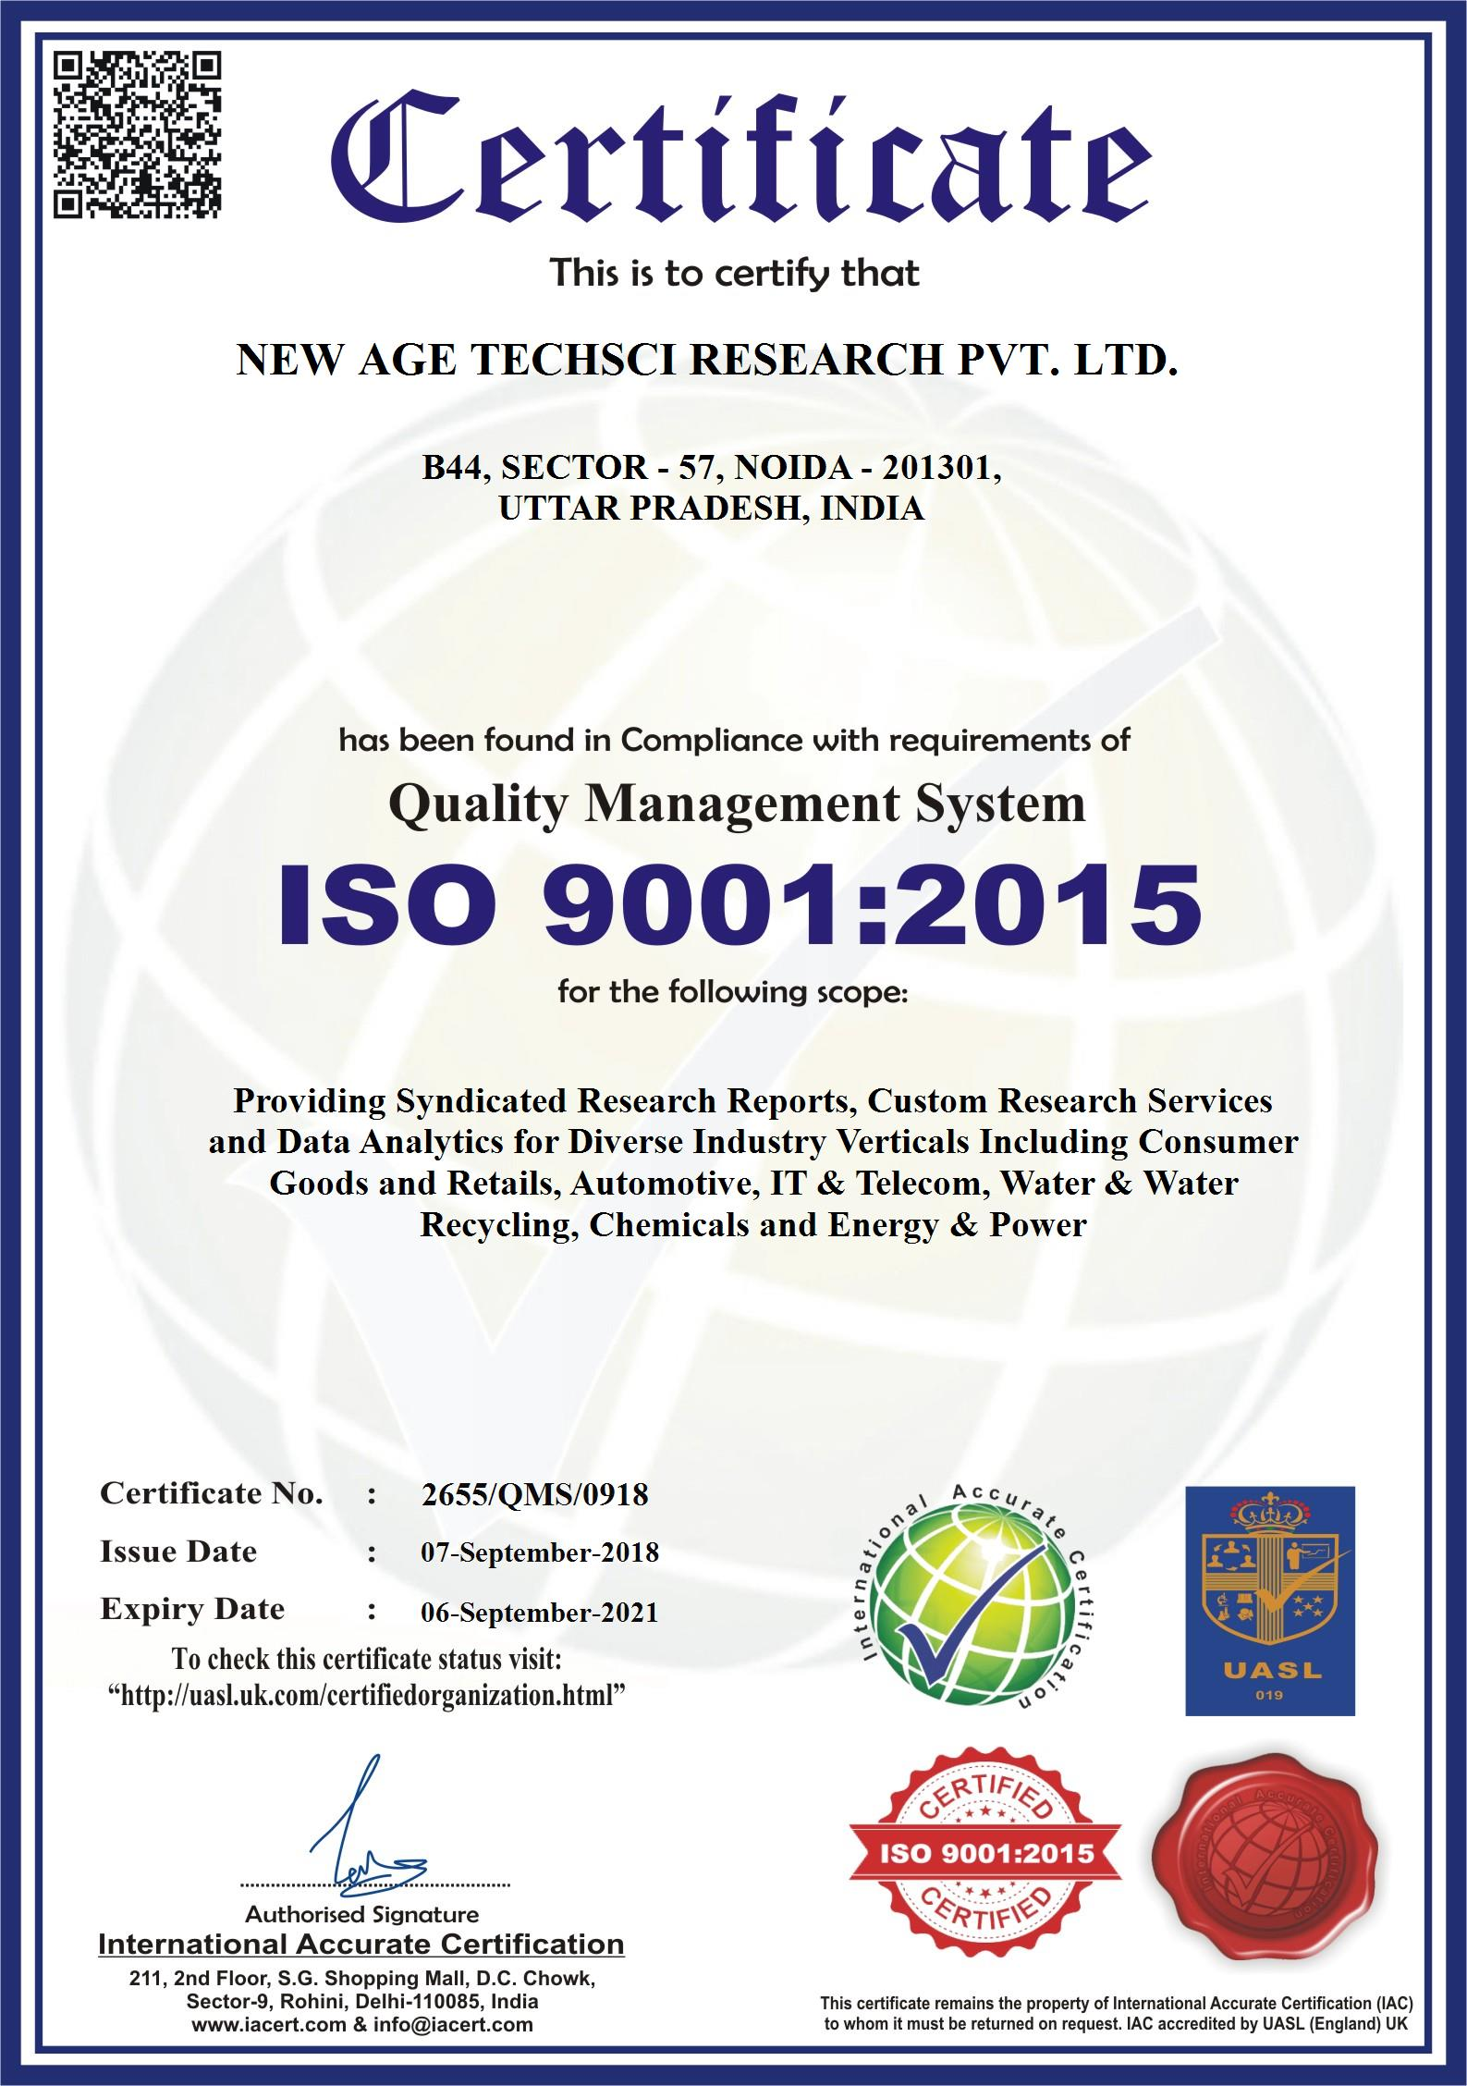

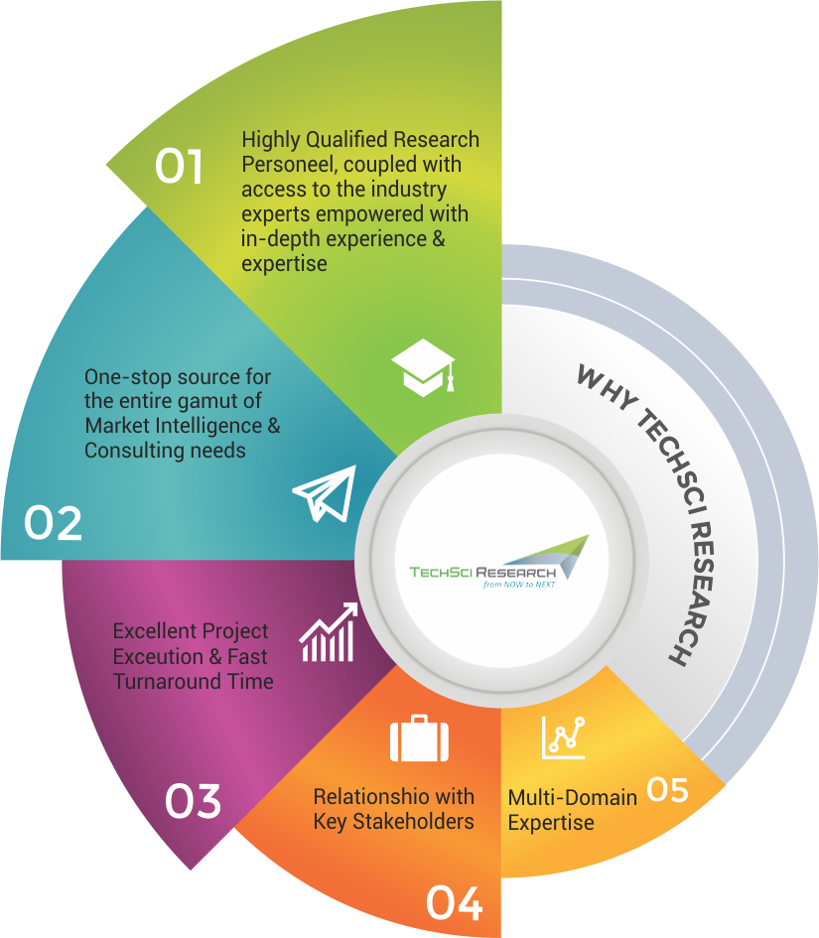
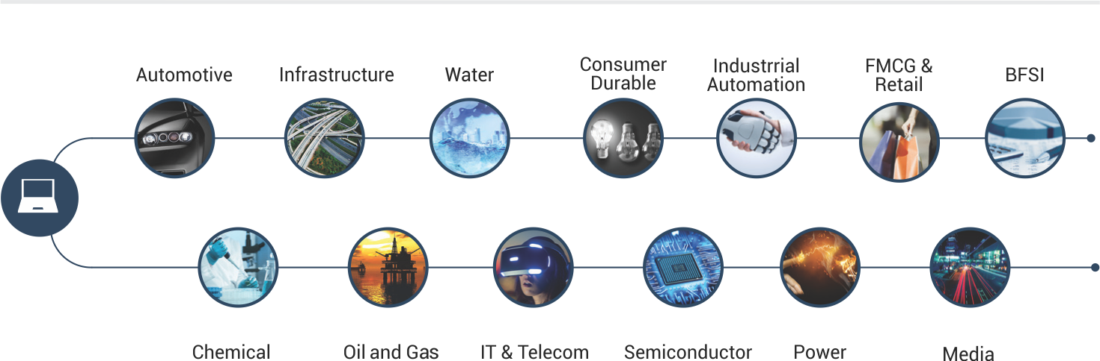
WE ARE TECHSCI RESEARCH
AND OUR SECTORIAL EXPERTISE
A global market research and India Entry Consulting firm focused on providing research and consulting services to its customers across the globe.
Asia Pacific
Europe & Russia
America
(North & South)
80
500+
1000+
2000
+
+
Africa & Middle East
Countries
Clients
Worldwide
Industry
Experts
Successful
Projects

Slide 16
Testimonials
It was indeed a very good experience .TechSci was able to provide us with all the details that we were looking in the study. A special thanks to the team for the strong support throughout the entire product launch journey.
Product Development Team
DAGA GLOBAL India Pvt. Ltd.
Happy with the delivery and quality. Also, the immediate response was much appreciated
Market Development Group Mitsui
Market
Exploration
Market
Potential
I am satisfied with overall performance of TechSci Research. Weekly updates before the final report were especially helpful and reassuring. Additional requests on the content of the interim and/or final reports were handled in a swift and professional manner.
Member Board of Directors,
Osaka Gas Co. Ltd
TechSci team quickly understood the research scope. The table of content was very much précised and pinpointed. Openness to adjust few additional scopes on an immediate basis highlights the flavour of relationship management. Mid-long business plan in the study was much helpful
Infromation Centre
Haifa Group
Positioning &
Communication
Product and solution Development / Launch
Market
Response
Competitor
Tracking
Thanks for a great job. We look forward to more research needs shortly for cross-verticals. We appreciate the quality of work and dedication to meet the deadline.
Market Planning Division
Gujarat State Fertilizers and Chemicals .
Very professionals and highly skilled professionals for Primary research to get ground-level data
New product Development Team
Sumitomo Corporation

Slide 17

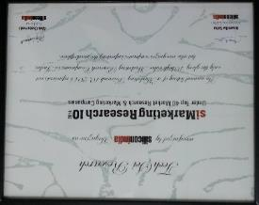
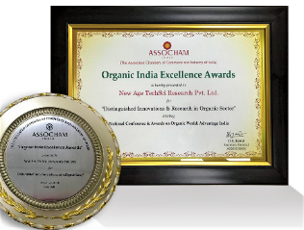

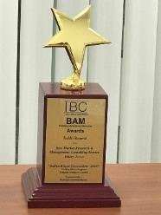
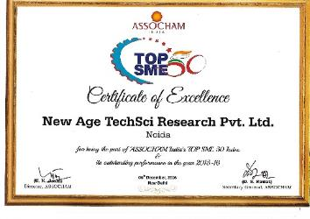

Awards & Recognitions
Recognition & Appreciation from WQIA
Recognition - Top 10 Market Research Company in India by Silicon India
Award Certificate of Distinguished Innovation & Research in Organic Sector By ASSOCHAM
Business-to-Business Research Award by ABP News
Best Market Research & Management Consulting Service by Wafisilpa Entertainments
Certificate of Excellence By ASSOCHAM
Application of Research Award by ABP News

Slide 18

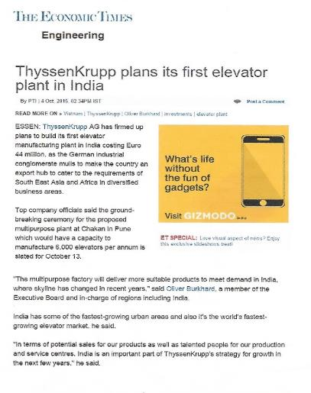
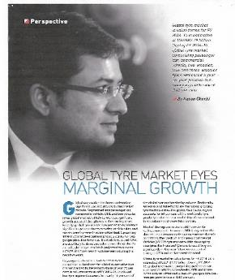
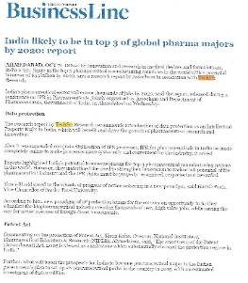
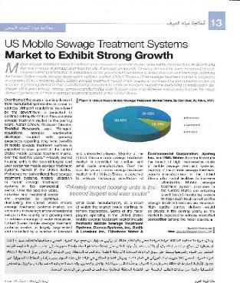


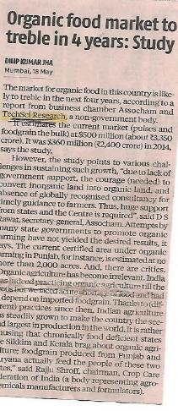
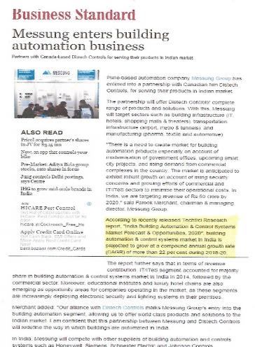
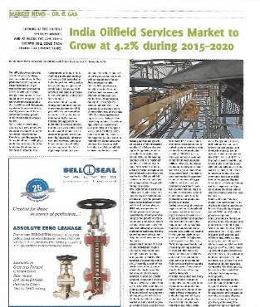
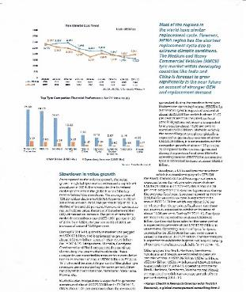

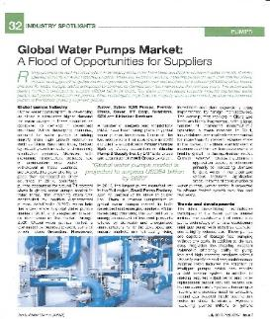



Media Coverage
Our research findings have been widely covered by most prestigious and credible media houses across the world.

Slide 19







CONTACT US
North America
TechSci Research LLC
708 3RD Avenue, 6th Floor, New York, NY United States 10017
Tel: +1- 646- 360-1656
Europe
TechSci Research
54, Oldbrook, Bretton,
Peterborough,
United Kingdom
Asia-Pacific
TechSci Research Pvt. Ltd.
B-44, Sector -57, Noida, National Capital Region, UP, India 201301
Tel: +91-120-4523900
Asia-Pacific
TechSci Research
A 404, Trade Square, Saki Naka,
Andheri East Mumbai, India
Tel: +91-9315563377
www.chemanalyst.com
INDUSTRY ASSOCIATIONS
The information contained herein is of a general nature and is not intended to address any particular situation, individual or entity. No one should act upon such information without appropriate professional advice.
2018 © ChemAnalyst Research All Rights Reserved.

